Slide 1
ASSESSING THE SALES PERFORMANCE OF THE PIZZA SHOP

Slide 2

TABLE OF CONTENT
BACKGROUND: BACKGROUND AND GOALS
ANALYZE DATA: EXPLORATORY DATA ANALYSIS
CONCLUSION AND RECOMMENDATION

Slide 3

BACKGROUND

Slide 4
BACKGROUND
This pizza shop operates every day, offering a variety of pizza flavors in various sizes
The shop owner seeks to gain new insights from the sales data in 2015
GOALS
Assess sales performance and adjust the supply of ingredients for the upcoming year

Slide 5

ANALYZE DATA

Slide 6

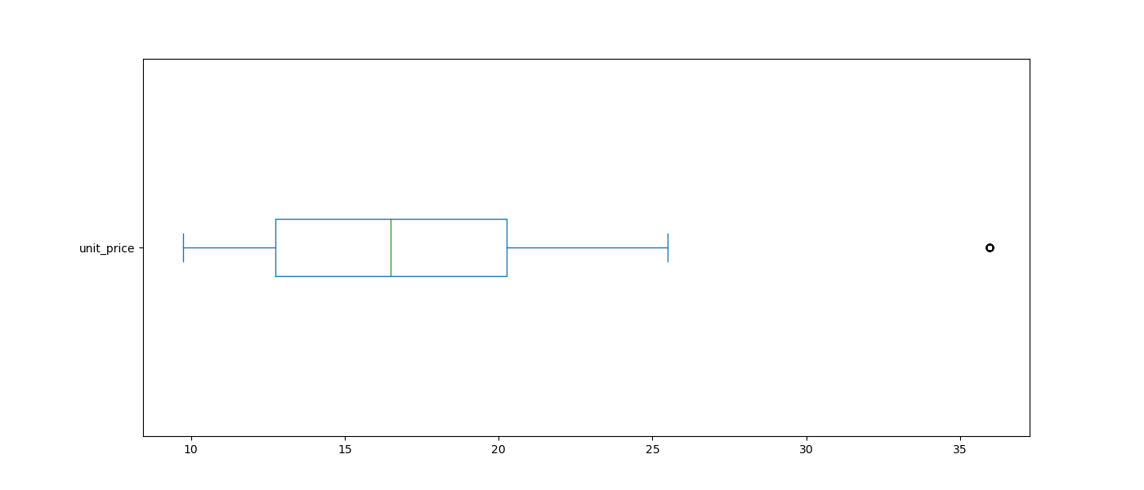
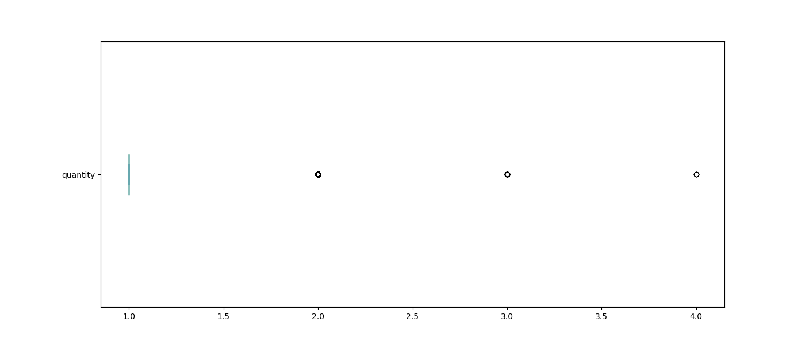
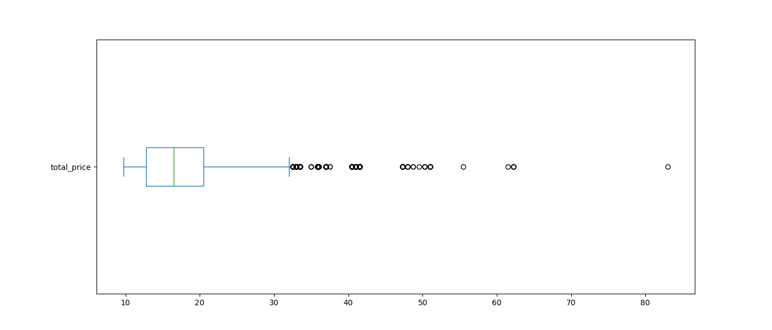
PRICE AND PURCHASE QUANTITY ANALYSIS
Unit Price Pizza
The average price of pizza is 16 USD
Pizza priced above 35 USD is The Greek Pizza
98% of transactions are for the purchase of one pizza
Purchase Quantity
Total Price Pizza

Slide 7
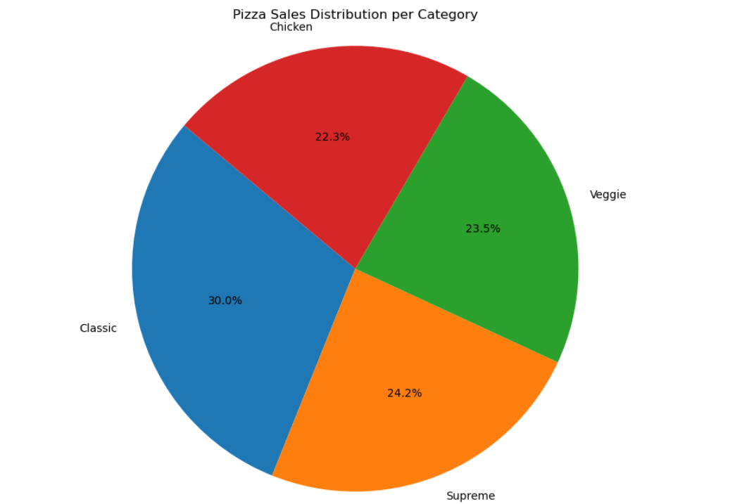
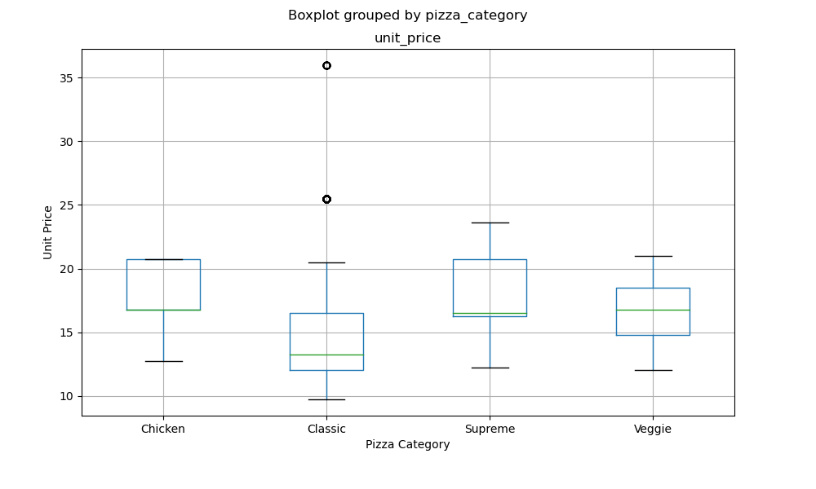
PURCHASE DISTRIBUTION OF PIZZA BY CATEGORY
The Classic Pizza category has lower prices compared to other categories
The classic pizza category is the most frequently purchased variant by customers
For pizzas priced above 25 and 35 USD in the classic category, are The Greek Pizza

Slide 8
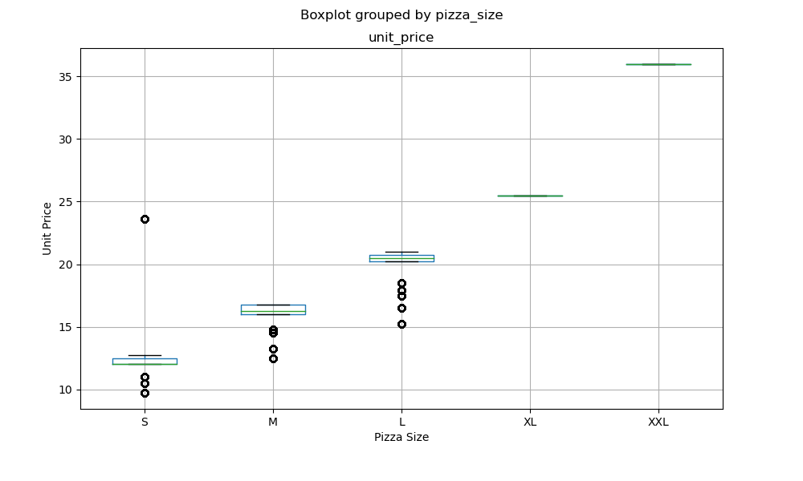
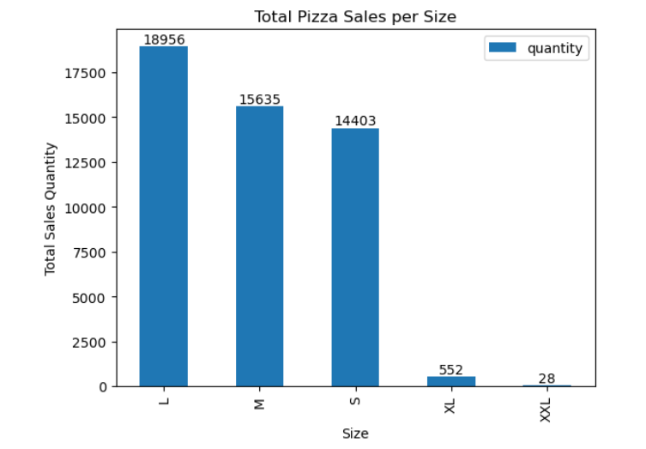
THE BEST-SELLING PIZZA SIZES
The most frequent pizza purchases are in 3 sizes: S, M, and L
Small-sized pizzas priced above 20 USD are The Brie Carre category
The Hawaiian Pizza, The Pepperoni-Mushroom-Peppers Pizza, The Pepperoni Pizza, The Five Cheese Pizza, and The Four Cheese Pizza are quite popular due to their relatively lower prices

Slide 9
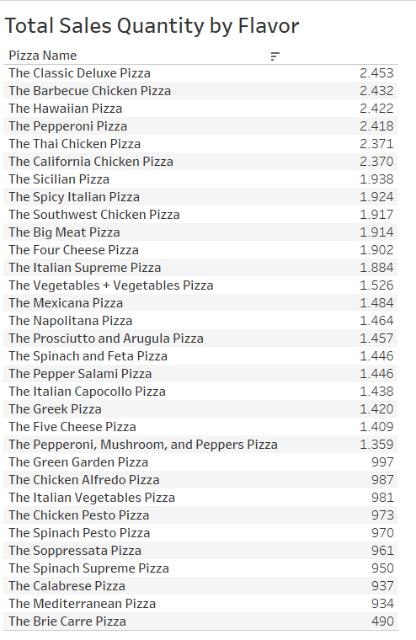
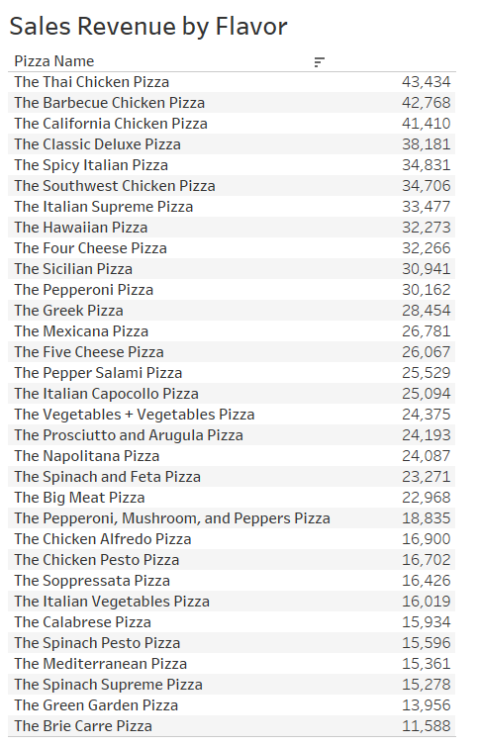
FAVORITE PIZZA FLAVORS
In some pizzas such as The Hawaiian Pizza, The Pepperoni-Mushroom-Peppers Pizza, The Pepperoni Pizza, The Five Cheese Pizza, and The Four Cheese Pizza, the prices are low
To break even, flavors like The Thai Chicken Pizza and The California Chicken Pizza are priced above average
Maximize sales for flavors like The Thai Chicken Pizza and The California Chicken Pizza

Slide 10
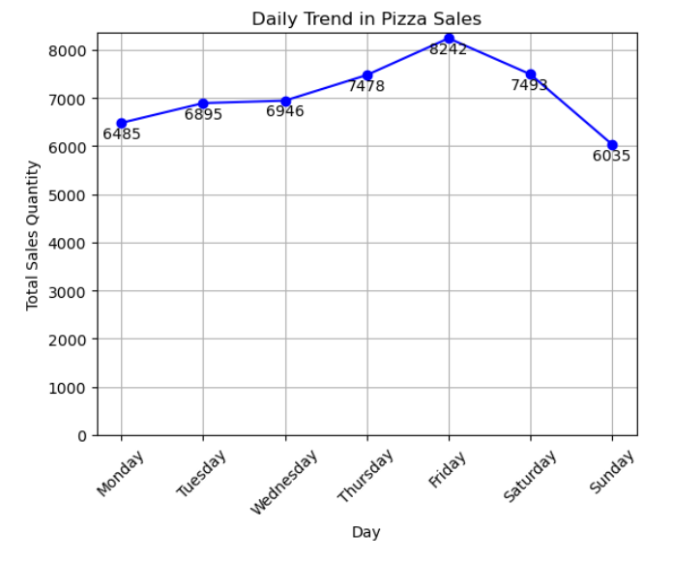
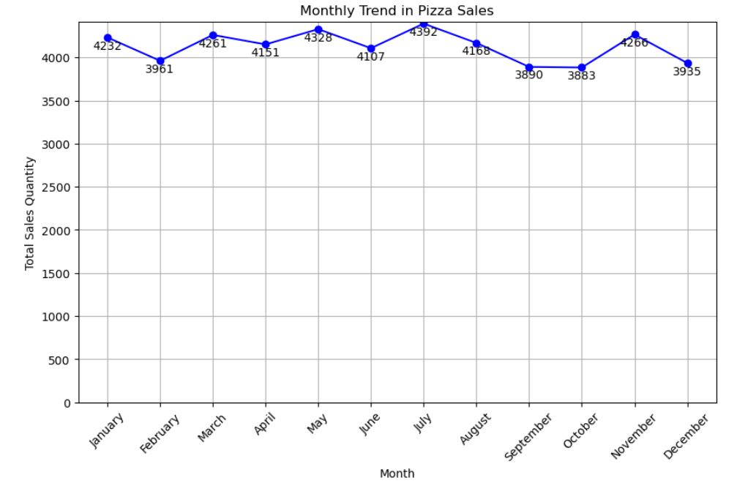
MONTHLY AND DAILY TREND
Considering adding staff on Fridays due to high sales
Sales fluctuate significantly on a monthly basis, with the highest sales occurring in July
There is a decline in February, September, and October, though not drastic

Slide 11
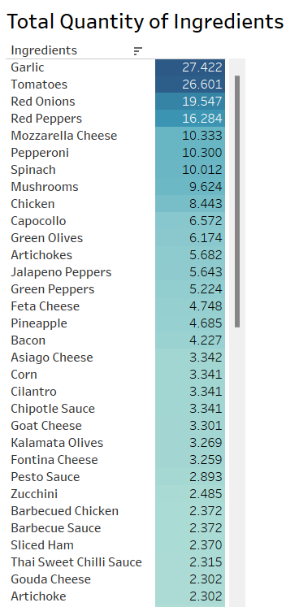
FOOD INGREDIENT USAGE
Garlic, tomatoes, onions, peppers, and cheese are frequently used ingredients throughout the year
Before entering busy months (March, May, July, November), it is essential to double-check the stock of frequently used ingredients

Slide 12

CONCLUSION AND RECOMMENDATION

Slide 13
CONCLUSION
The highest sales day falls on Friday, and the peak sales month is May and July.
Customers prefer classic category pizzas, and they tend to order large-sized pizzas.
Garlic, tomatoes, onions, peppers, and chicken are frequently used ingredients throughout the year.
The Classic pizza category tends to have lower unit prices. The Classic pizza category is also the most frequently purchased or the most favorite, which may occur due to its relatively affordable price.
The Brie Carre Pizza has the lowest sales, which is due to its relatively high unit price. The Brie Carre Pizza in size S is relatively more expensive than other pizzas in size S.

Slide 14
RECOMMENDATION
Consider adding extra staff to the pizza shop on Thursdays, Fridays, and Saturdays.
Simplify the pizza size options to small, medium, and large. The purchase of XL and XXL-sized pizzas only occurs for The Greek Pizza.
Increase stock levels for ingredients such as garlic, tomatoes, onions, peppers, and chicken due to their frequent usage.
The majority of customers only buy 1 pizza. Purchases with quantities above 1 account for only 2% of the total purchases. To increase sales, attractive promo can also be implemented to encourage customers to buy more than 1 pizza.

Slide 15
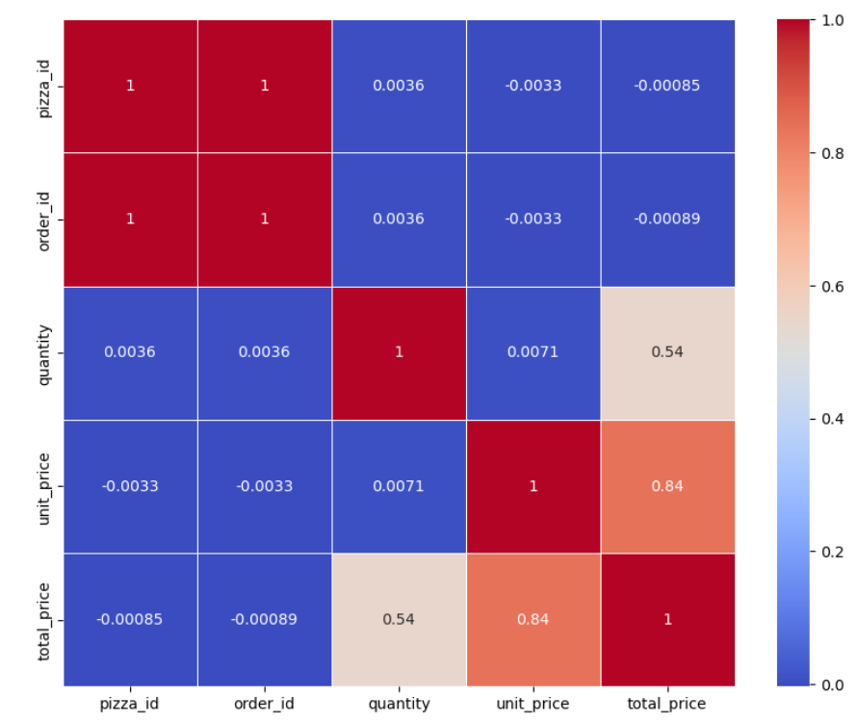
HOW TO INCREASE SALES?
To increase sales, offering attractive promotions can be considered
The quantity and unit price have a significant correlation with the total price
For promo, we can also slightly decrease the unit price, with the hope that the quantity will increase, thus resulting in an increase in total sales

